Slide 1
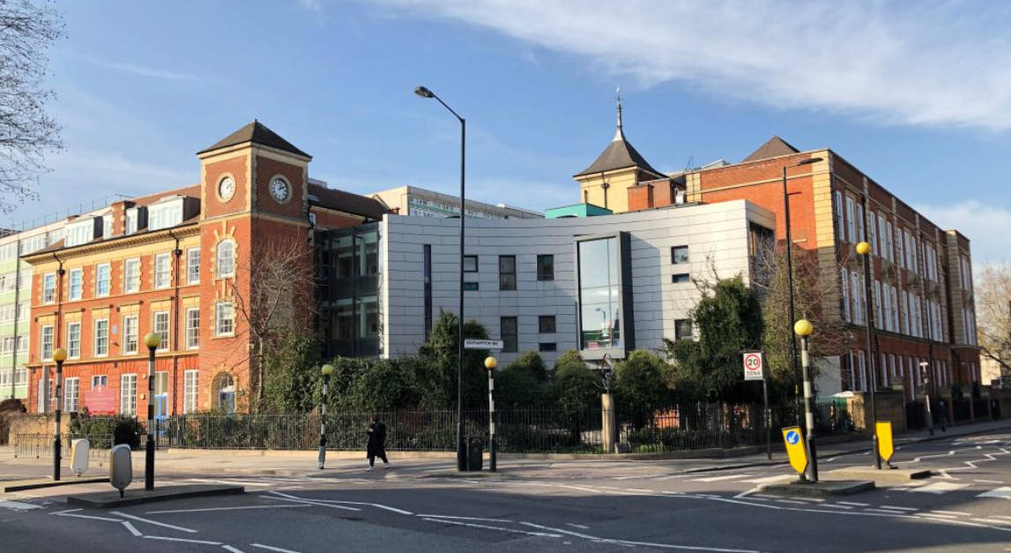
Welcome to Year 3

Slide 2
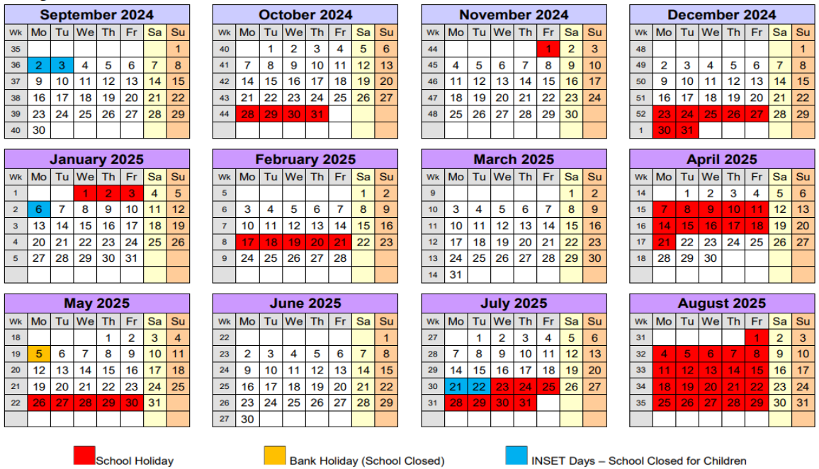
Purpose of the Meeting
An opportunity to meet you before Parents’ Evening
Introduce staff in the team who help your child
Share important information

Slide 3
Year 3 Staff Team:
Ms Abraham (Orion) Ms Adenaike (Columbia) (Class Teacher)
Ms Lopez-Lopez (Orion) Mrs Baker (Columbia)(Teaching Assistant)
For ½ a day per week Orion and Columbia class will be taught by Ms Naylor which is a national requirement and facilitates team planning.

Slide 4
Senior staff throughout the school
Headteacher – Ms Thangarajah
Deputy Head – Ms Machaliwa
SENCo/Assistant Head – Ms Pugsley
EYFS lead / Assistant Head – Ms Naylor
Pastoral and safeguarding Lead – Ms Tirvengadum

Slide 5
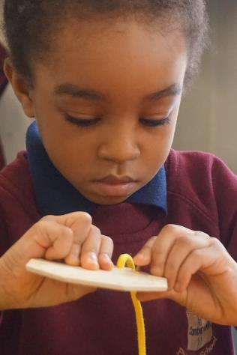
Uniform
We are extremely proud of the uniform that the children wear.
All children should wear a full school uniform everyday, including a sweatshirt with the school logo and black shoes (no trainers please).
It is expected that children wear full PE kit during PE lessons- dark tracksuit bottoms are acceptable in the winter months. Our PE days are Monday
Please ensure that your child’s uniform is clearly labelled to minimise lost property.
Please note that nail varnish is not allowed in school.

Slide 6
Attendance
Attendance every day is vital – please consider very carefully whether its essential that your child misses a whole day of learning.
On the rare occasion that your chid is not able to come to school, please inform the office at the earliest convenience.
Gates open at 8.40am for a 8:45am start 5 minutes late each morning is 25 minutes per week and 3 days lost learning a year!
Attendance is monitored by the senior and family support team.
If you need any support, please don’t hesitate to get in touch.

Slide 7
Home learning Expectations
Homework is really important, but we want it to be as stress free for parents / carers as possible.
Homework day for our class is given on Friday and should be returned on Tuesday.
Homework reinforces basic skills and gives extra practise for what has been learnt in class.
Our weekly spelling test will be on Wednesday.
We ask you to encourage good routines, ensuring that you child has a quiet space in order to complete their homework to a high standards.
If your child cannot complete their homework, please ensure you inform their class teacher.

Slide 8
Additional provision
BC and ASC
We have a breakfast club every morning starting at 7:30am and an after school club, which provides after school care until 5:30pm. Both clubs are accessed by a separate gate at the side of the school on Southampton Way.
To book a place please, contact the school office and they can confirm a place with you through Parent Pay.
Enrichment clubs
We have a range of enrichment clubs throughout the year. Notifications will be sent out on the website and this is booked via the school office and Parent Pay.

Slide 9
Daily Supported Reading
Reading is a fundamental life skill and in order for our children to become confident readers we provide opportunities for them to read to an adult everyday in school.
Daily Supported Reading (DSR) provides an opportunity for all children within Year 1 and 2 to read to an adult every day in a small group.
DSR happens daily in 30 minutes sessions.
Adults working with groups track and monitor children reading book bands, ask children comprehension questions and plan exciting activities that promote enjoyment of reading.

Slide 10
Destination Reader
KS2: Years 3, 4, 5 and 6.
Reading is a fundamental life skill and in order for our children to become confident readers we provide opportunities for them to read everyday in school.
Destination Reader is an approach that involves daily sessions where children apply the skills of reading through partner work and independent reading.
Children deepen their understanding of the text they read through the use of a series of strategies.
Destination Reader supports reading for pleasure and purpose
A wide range of texts are used in order to create deep understanding of texts.

Slide 11
Reading with Your Child
This is one of the most important things that you can do to help him / her make maximum progress.
Read for a short time each day ask questions about the text and pictures using the prompts inside the diary.
Even older children need to be heard reading.
If your child is in nursery, reception or years 1-3 you must sign your child’s reading diary every day. If your child is in years 4-6, they must write a comment and complete a reading task each day.
Please make sure that they bring in their reading diary with their reading book and book bag every day. This is an important routine to get into.
Please also feel free to use the reading diary as a communication tool with us any key messages for the week.
Remember to use the diary as a way of recording your child’s achievements- positivity goes a long way

Slide 12
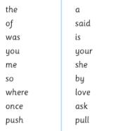
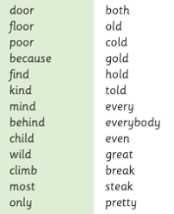
Spelling
Each child will follow the NC recommended word banks.
Spelling will be taught in class twice a week looking in detail at the spelling patterns and high frequency words.
List of these words can be found in your child’s reading diary in order to assist you practising at home.
Practising spellings on a weekly basis will support your child in becoming a more confident writer.
Spellings may also form part of your child’s weekly homework.

Slide 13
Assessment
Teachers are responsible for the ongoing assessment of every child in the class.
It is of the upmost importance that all children make rapid progress in order to meet their full potential across all areas of the curriculum.
Assessment in reading, writing , maths and science is more rigorously monitored in line with national expectations.
As a school we will report your child’s progress and attainment during parents meetings in the Autumn and Spring term.
Autumn Parents’ meeting is December 11th 2024
Spring Parents’ meeting is May 21st 2025
At the end of the academic year there will be a parents open day to review your child’s learning throughout the year.

Slide 14
Assessment continued
The National Curriculum will continue to be embedded which sets higher expectations of children than in previous years.
Children will be assessed against year group specific criteria and teachers will report whether your child is:
Working towards the expected standard for their age
Working at the expected standard for their age
Working at greater depth for their age
Teachers will be able to provide you with more detail throughout the year as to your child’s successes and next steps.
Teachers are always willing to discuss your child’s progress at any point throughout the year so feel free to make an appointment, if necessary.

Slide 15
Weekly Routines
At the end of the day please make sure you wait outside the gate or door in the playground until the class teacher dismisses your child. If you can not collect your child please make sure you have informed the office with the name of the person who is collecting them. We cannot hand your child over to a person without prior permission.
Headteacher’s Award and Reading Award Assemblies are held weekly - look out for your postcard!
Keeping in touch (Reading diaries) and daily communication in the playground.
Ensure your contact details are up to date in the school office.
Check the class blog for posts about what the children have been learning.
Please check the website regularly for news, letters and information regarding clubs and events.

